Slide 1
Chapter 12 Introduction of Object Detection
(Theme 3)
Prof. Lin ZHANG
School of Computer Science and Technology
Tongji University

Slide 2
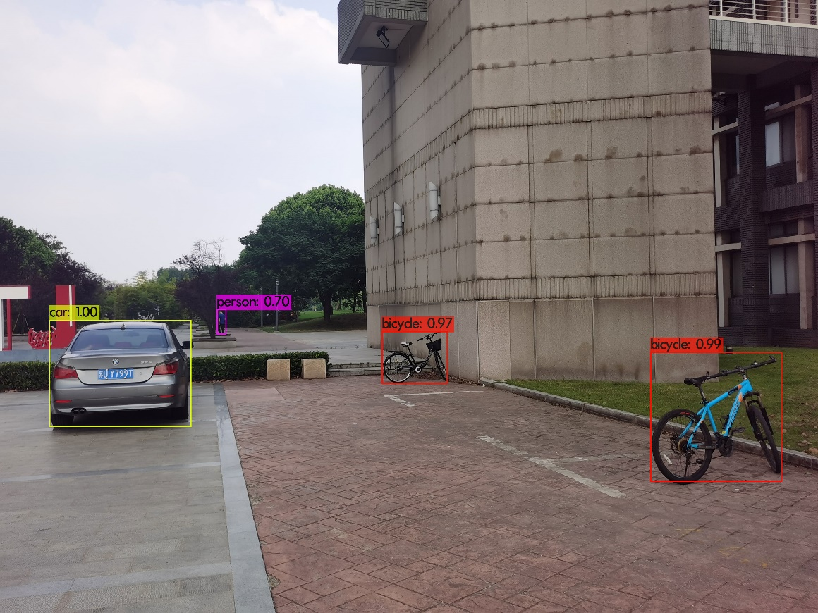
Problem definition of object detection
Multiple objects detection

Slide 3
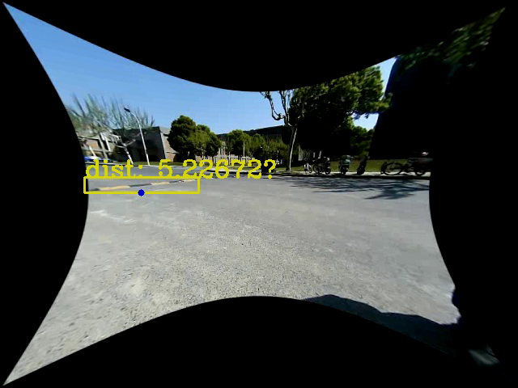
Problem definition of object detection
Perform object detection on each video frame

Slide 4
Problem definition of object detection
Object detection is a fundamental task in computer vision that involves identifying and locating objects within an image or video. This capability is crucial for a wide range of applications, from autonomous driving and surveillance to medical imaging and retail analytics
Challenges in object detection
Variability in object appearance: Objects can appear in various shapes, sizes, colors, and orientations
Occlusion: objects may be partially hidden by other objects, making them difficult to detect
Complex backgrounds: Cluttered or dynamic backgrounds can interfere with object detection
Real-time processing: Many applications require object detection to be performed in real-time, necessitating efficient algorithms

Slide 5
Popular object detection algorithms
Traditional Methods
Haar Cascades: Used for face detection, relying on handcrafted features
HOG (Histogram of Oriented Gradients) + SVM (Support Vector Machine): Effective for pedestrian detection
Deep Learning-Based Methods
R-CNN (Region-based Convolutional Neural Networks): Proposes regions and classifies them using CNNs
Fast R-CNN: Improves R-CNN by sharing computation across region proposals
Faster R-CNN: Introduces Region Proposal Networks (RPN) for faster processing
YOLO (You Only Look Once): A single-shot detector that predicts bounding boxes and class probabilities directly from full images in one forward pass
SSD (Single Shot Multibox Detector): Balances speed and accuracy by predicting bounding boxes at multiple scales
DETR (DEtection TRansformer): an object detector using a transformer architecture

Slide 6
Contents of this theme
SVM is classical classification approach; to learn it, some knowledge about convex optimization is necessary, which will be covered in Chapter 13
SVM+HoG based object detector will be introduced in Chapter 14
Fundamental knowledge about CNNs and YOLO will be detailed in Chapter 15

Slide 7
Contents of this theme
应用
智能监控
智慧零售
服务型机器人
军事侦察
技术
图像中的目标检测
感知器分类算法
SVM+HOG目前检测算法
YOLO系列目标检测算法
线性支持向量机
非线性支持向量机
算法
多类分类支持向量机
卷积神经网络及其训练
批归一化
残差神经网络
两类交叉熵损失函数
凸集与仿射集
仿射包
内部与相对内部
凸函数及其判定条件
凸优化问题
凸二次规划问题
数学
对偶函数
对偶问题
对偶间隔
强对偶性与斯莱特条件
针对一般优化问题的KKT条件
针对凸优化问题的KKT条件

Slide 8


